Slide 1


Blockchain technology
M.Koushitha Reddy
20RH1A6635
CSE(AIML)

Slide 2
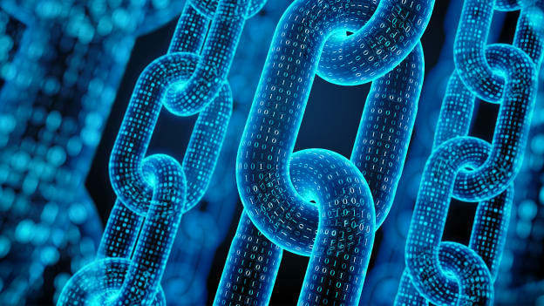
What is blockchain?
blockchain is decentralized, distributed, public leger system
A blockchain, originally block chain, is a growing list of records, called blocks, that are linked using cryptography. Each block contains a cryptographic hash of the previous block, a timestamp, and transaction data

Slide 3
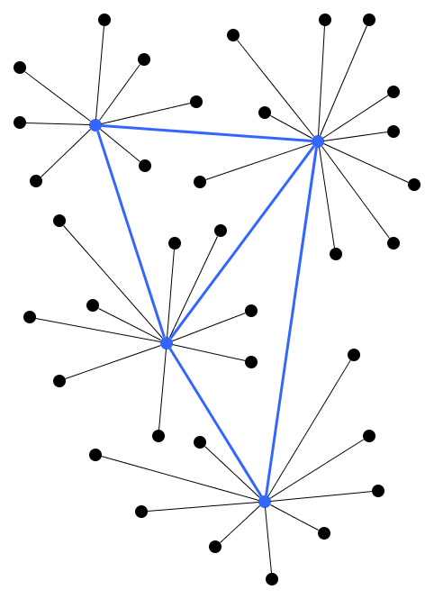
DeCentralization
Organisation of network where decision regarding the organisations are made by a chosen group of people in a centralised system
Decentralised system it is exactly the opposite of a centralised system it is when a service is ruled by no single governing authority
.

Slide 4

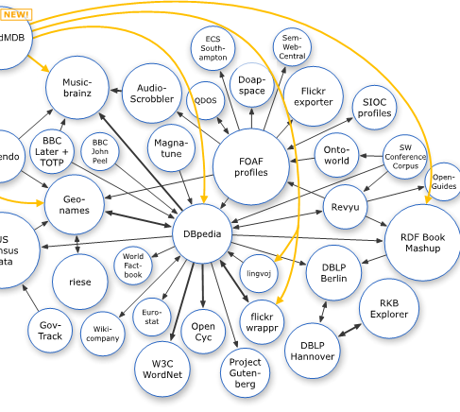
Distributed
The decentralized database managed by multiple participants is known as a decentralized ledger technology blockchain is a type of dlt in which transactions are recorded with an immutable cryptographic signature called a hash

Slide 5
Features Of blockchain technology
Peer to peer network
hash encryption
Proof of work

Slide 6
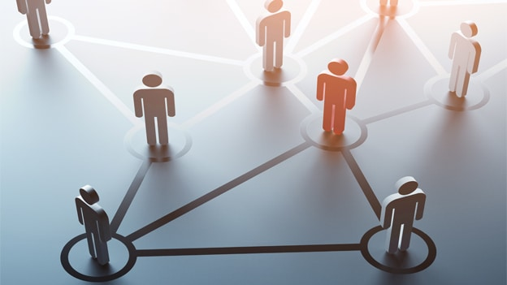
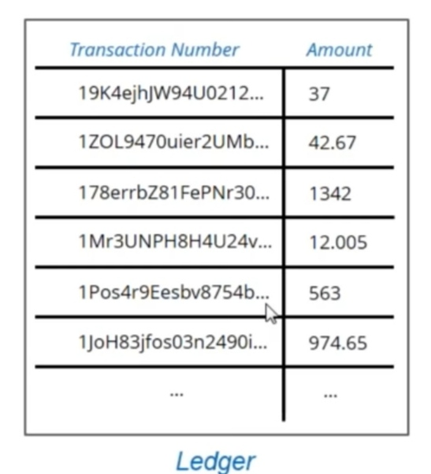
Peer to peer network
All blockchain runs on the distributed peer-to-peer networks
Every single person on a network has a copy of the ledger there is not signal centralised original copy

Slide 7
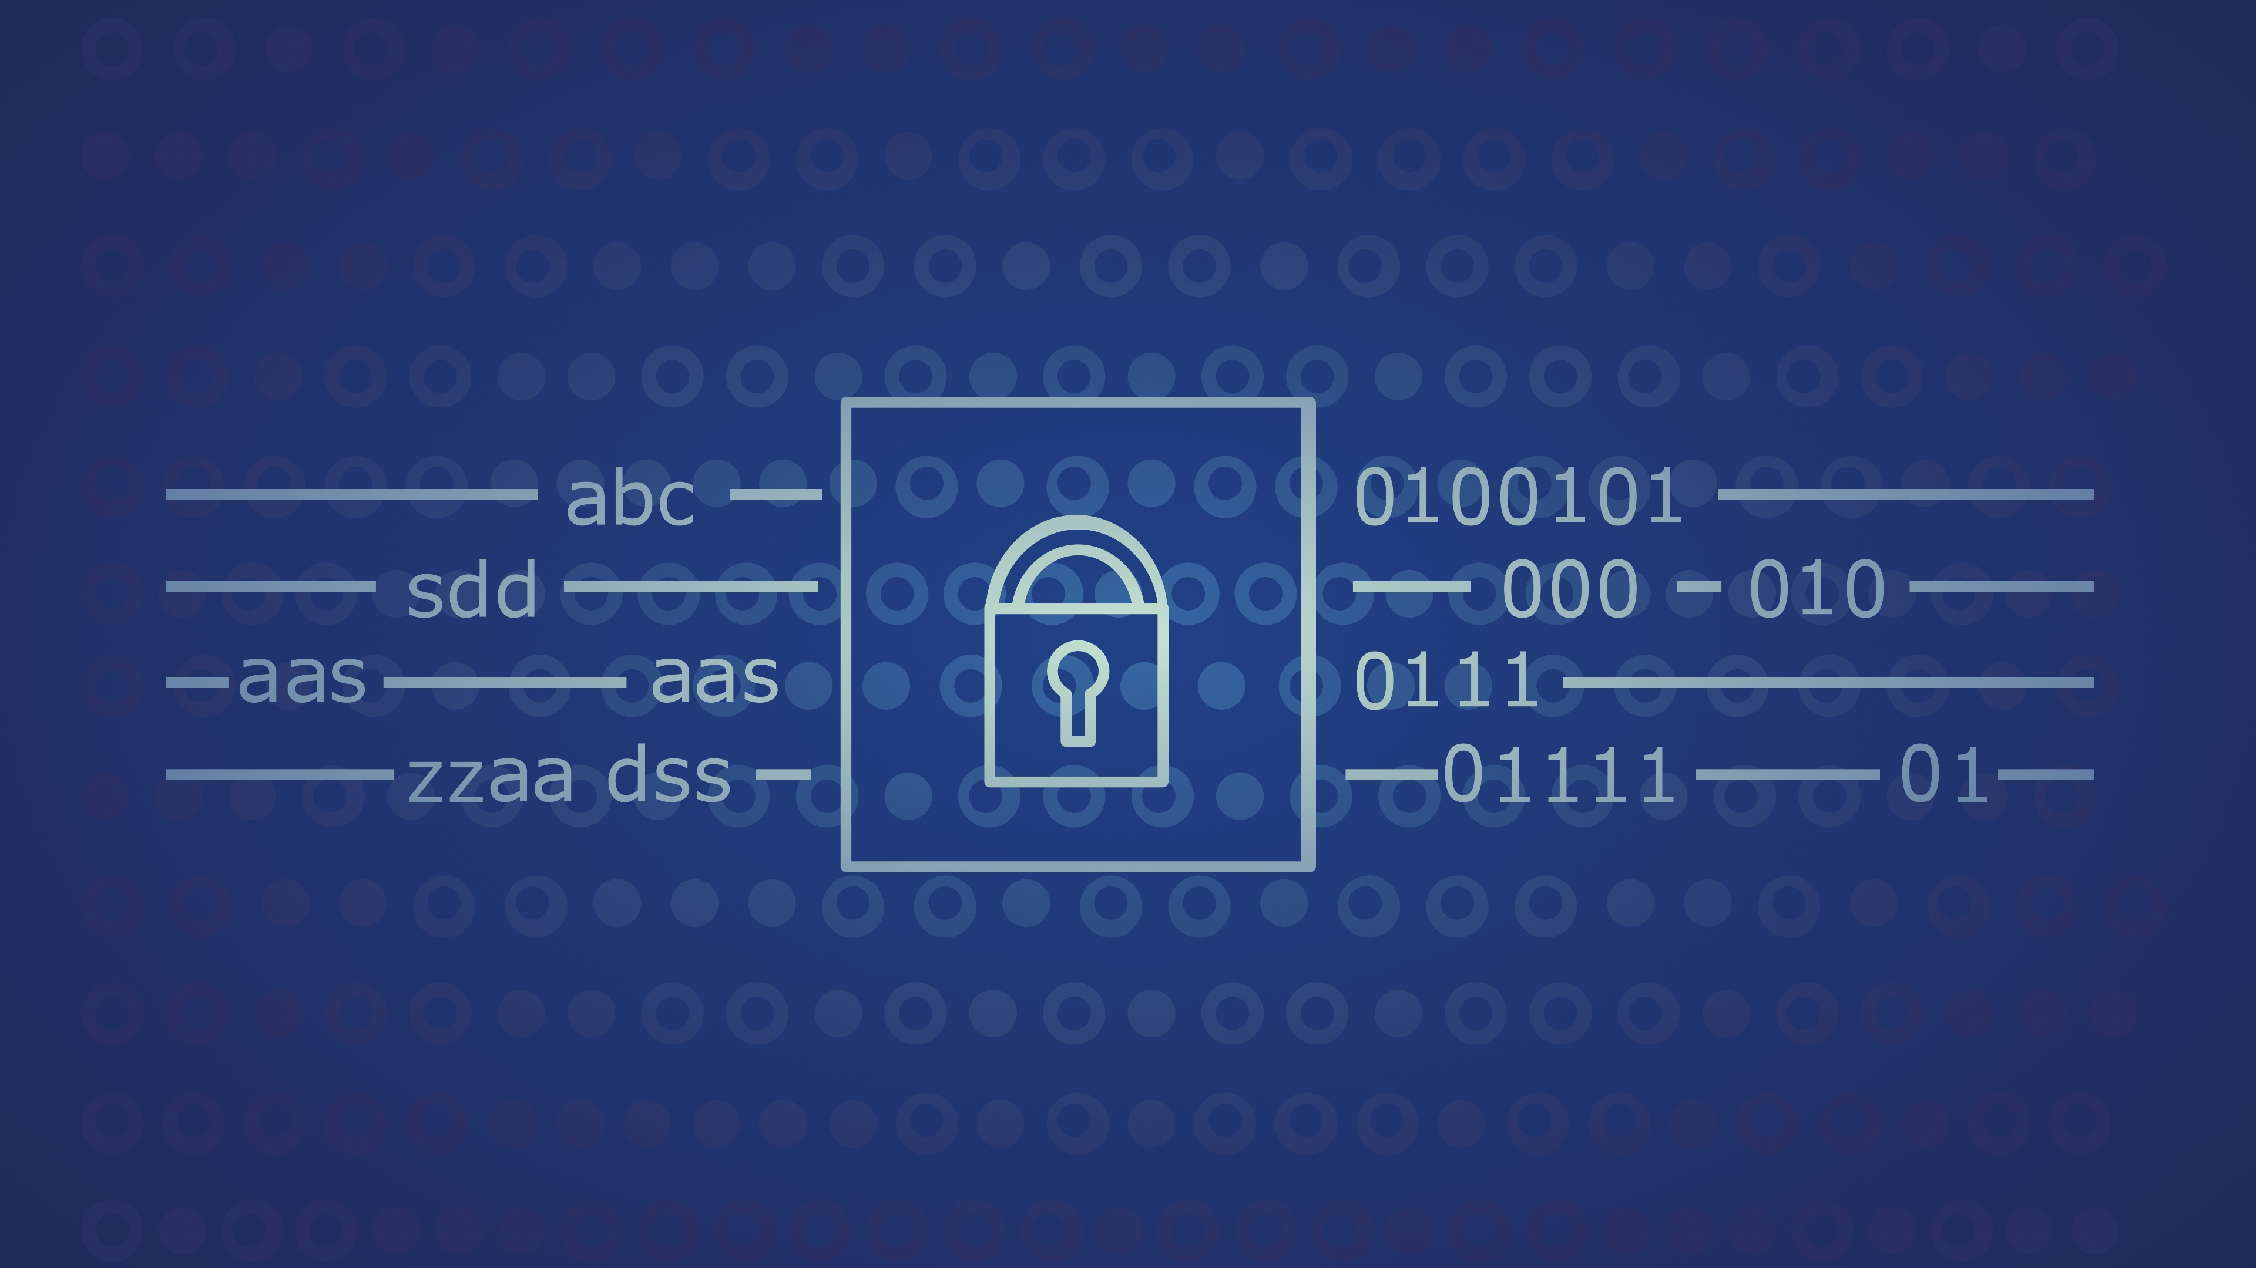
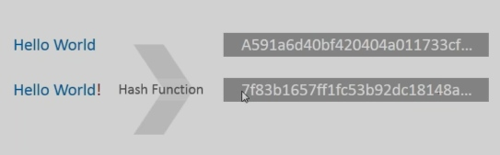
Hash encryption
All data stored in the blockchain is encrypted using hash functions

Slide 8
Proof of work
Proof of work involves solving computational expensive puzzle to add blocks to the blockchain
Bitcoin has miners who validate have to solve a complex mathematical puzzle to add a block to the blockchain
Miner search for a specific nonce which give the desire hash which is Predetermined

Slide 9
Advantages of blockchain
Better transparency
Enhanced security
Reduced cost
True traceability
Improved Speed and highly efficient

Slide 10
Disadvantages of blockchain
Some blockchain solutions consume too much energy
Blockchain cannot go back data is immutable
Blockchains are sometimes inefficient
It limits the number of transactions

Slide 11


